Slide 1



























INT104 – Database Management System Unit – III

Slide 2

Deadlock Detection
Starvation
2

Slide 3
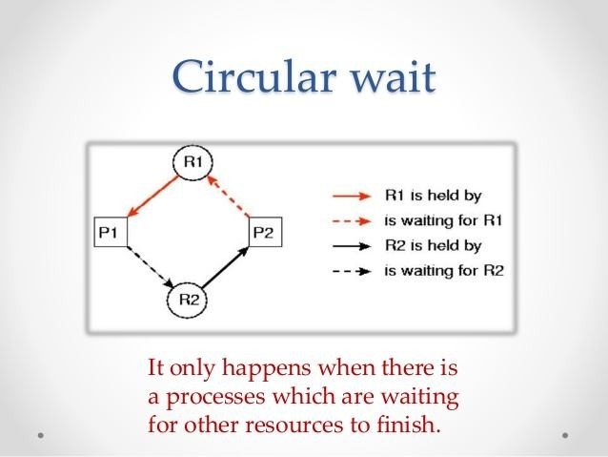
Dealing with Deadlock
Deadlock avoidance
There are many variations of two-phase locking algorithm.
Some avoid deadlock by not letting the cycle to complete.
That is as soon as the algorithm discovers that blocking a transaction is likely to create a cycle,
it rolls back the transaction.
➢
Wound-Wait and Wait-Die
algorithms use timestamps to avoid deadlocks by rolling-back victim.

Slide 4
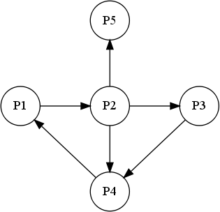
Dealing with Deadlock
Deadlock detection
➢
In this approach, deadlocks are allowed to happen.
➢
The scheduler maintains a wait-for-
graph for detecting cycle.
➢
If a cycle exists, then one transaction involved in the cycle is selected (victim) and rolled-back.
A wait-for-graph is created using the lock table.
As soon as a transaction is blocked, it is added to the graph.
One of the transaction of the cycle is selected and rolled back.
➢
➢
➢

Slide 5

Deadlock detection
One problem with this approach is the matter of determining when the system should check for a deadlock.
One possibility is to check for a cycle every time an edge is added to the waitfor graph, but this may cause excessive overhead.
Criteria such as
the number of currently executing transactions
or the period of time several transactions have been waiting to lock items may be used instead to check for a cycle

Slide 6
Deadlock detection
If the system is in a state of deadlock, some of the transactions causing the deadlock must be aborted.
Choosing which transactions to abort is known as victim selection.
The algorithm for victim selection
Should generally avoid selecting transactions that have been running for a long time
That have performed many updates
It should try instead to select transactions that have not made many changes (younger transactions).

Slide 7
Timeouts.
Another simple scheme to deal with deadlock is the use of
timeouts.
This method is practical because of its low overhead and simplicity.
In this method,
if a transaction waits for a period longer than a system- defined timeout period
The system assumes that the transaction may be
a
deadlocked and aborts it - regardless of whether
deadlock actually exists.

Slide 8
Starvation
Another problem that may occur when we use locking is
starvation,
which occurs when a transaction cannot proceed for an indefinite period of time
while other transactions in the system continue normally.
This may occur if the waiting scheme for locked items is unfair in that it gives priority to some transactions over others.
One solution for starvation is to have a fair waiting scheme, such as using a first-come-first-served queue; transactions are enabled to lock an item in the order in which they originally requested the lock.

Slide 9
Starvation
Another scheme allows
some transactions to have priority over others
but increases the priority of a transaction the longer it waits, until it eventually gets the highest priority and proceeds.
Starvation can also occur because of victim selection
if the algorithm selects the same transaction as victim repeatedly
thus causing it to abort and never finish execution.

Slide 10
Starvation
The algorithm can use higher priorities for transactions that have been aborted multiple times to avoid this problem.
The wait-die and wound-wait schemes discussed previously avoid starvation,
because they restart a transaction that has been aborted with its same original timestamp
so the possibility that the same transaction is aborted repeatedly is slim.

Slide 11

Deadlock Detection
Starvation

Slide 12






